Slide 1
Reengineering Alitheia Core
Herman Banken
&
Marieke van der Tuin

Slide 2
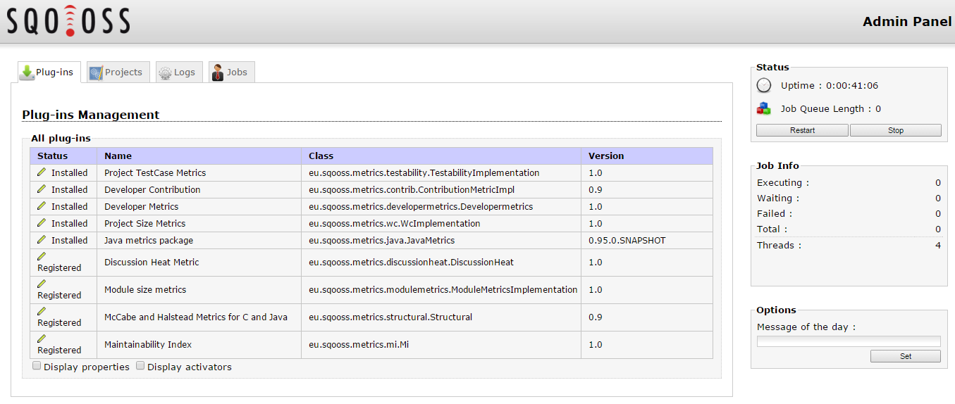
Problem
HTML for Web Admin in Java files:
→ Not easy to understand
→ Not modifiable or extensible

Slide 3
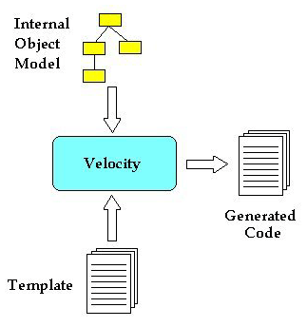
Apache Velocity
Already used → no new packages needed!

Slide 4
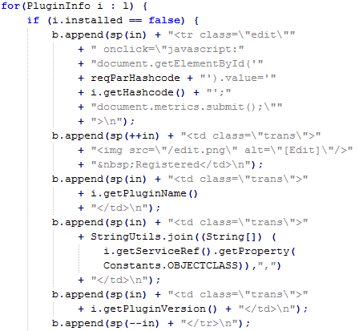

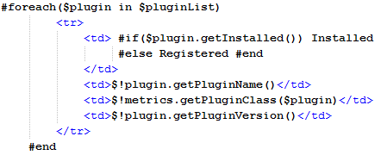
Before
After
PluginsView.java
PluginsView.java
plugins/list.html

Slide 5
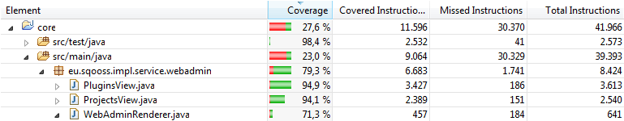
Testing
To ensure code still works correctly

Slide 6
Improvements to WebAdmin
Understandable
Maintainable, extensible, modifiable
Improvement in tests

Slide 7
Code quality
# of lines decreases from 2029 to 1243
# of lines/method decreases from 28.71 to 11.11
Complexity decreases from 4.96 to 2.47
Functionality stays the same!

Slide 8
More improvements
WebAdmin is only a small part of Alitheia Core
By reengineering other parts of Alitheia Core
Easy to maintain
Easy to directly understand code
Ready for possible extensions in future

